Slide 1
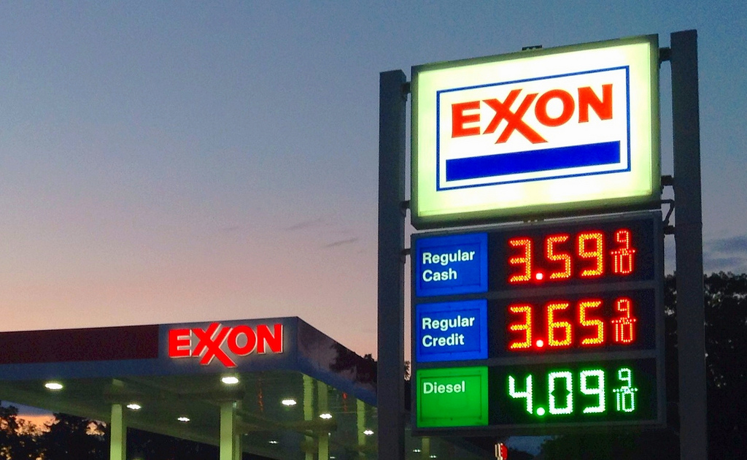

Taking on the world’s toughest energy challenges….
BY: KALYANI AND VAIRAVAN

Slide 2




COMPANY OVERVIEW:
Exxon Mobil is a U.S.-based oil and gas company which was formed in 1999 through the merger of Exxon Corporation and Mobil Corporation.
The company was founded by John D. Rockefeller in 1882 and is headquartered in Irving, TX.
Exxon Mobil Corporation has several divisions and hundreds of affiliates, many with names that include ExxonMobil, Exxon, Esso, Mobil or XTO.
Exxon Mobil Corp. engages in the exploration, development, and distribution of oil, gas, and petroleum products.
Stock Price: $ 108.99 as of 10-05-2023

Slide 3
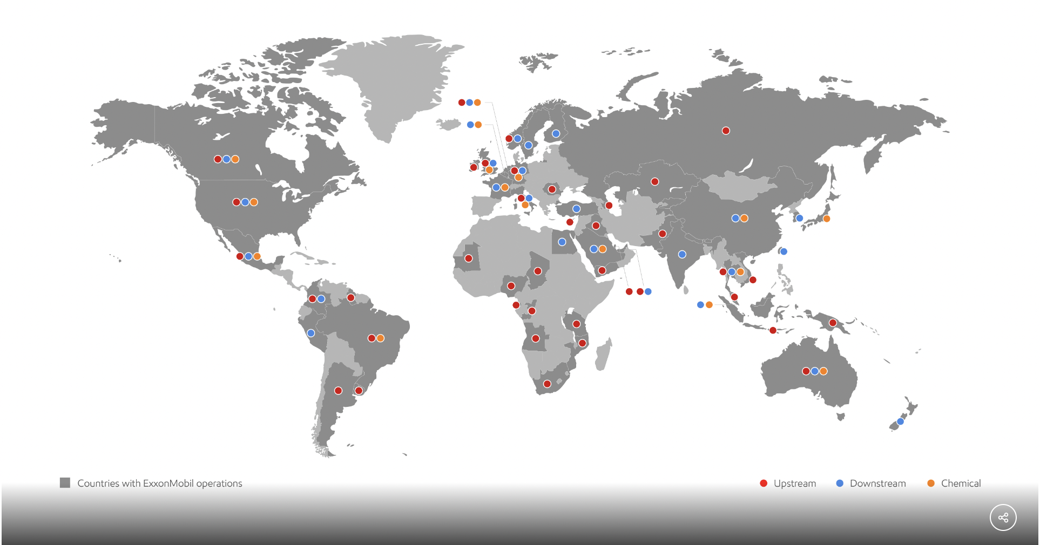

A global Presence
The ExxonMobil global presence map shows the company's operations in over 50 countries around the world.
The company's major upstream regions include the United States, Canada, Brazil, Angola, Nigeria, Kazakhstan, and Russia.
Its major downstream regions include the United States, Europe, Asia, and Latin America.
The company's major chemical regions include the United States, Europe, Asia, and the Middle East.
ExxonMobil has over 12,000 gas stations in the United States with 62,000+ Employees.

Slide 4
XOM EARNINGS BY Business segments:
It operates through the following segments:
Upstream, Downstream and Chemical.
The Upstream segment produces crude oil and natural gas.
The Downstream segment manufactures and trades petroleum products.
The Chemical segment offers petrochemicals.
ExxonMobil's total earnings for the second quarter of 2023 were $7.9 billion compared with first-quarter earnings of $11.4 billion.
Segment | Earnings (in Millions)
Upstream | $4,577
Downstream | $2,310
Chemical | $828
Speciality Products | 671
Corporate and Financing | ($506)
Total | $7,880
Notes:
The graph shows that ExxonMobil's upstream segment, which includes oil and gas production, was the most profitable segment in the second quarter of 2023,
generating earnings of $4.6 billion. The downstream segment, which includes refining and marketing, was the second most profitable segment, generating earnings of $2.8 billion. The chemical segment was the least profitable segment, generating earnings of $0.8 billion. Overall, ExxonMobil's second quarter earnings were $8.2 billion, which was up from $6.2 billion in the first quarter of 2023. The increase in earnings was driven by higher oil and gas prices and production growth from its Permian Basin and Guyana operations.

Slide 5
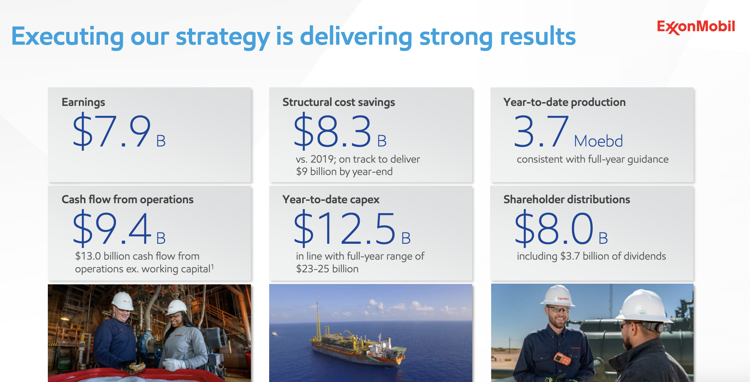
Nearly doubled reported earnings versus 2Q18, a comparable price environment
Structural cost saving of $8.3 billion and about to deliver $9 Billion by year end.
Continuing to capture benefits of our unique scale, integration, and technology .
Strong results supporting advantaged investments and shareholder returns .
Accelerating profitable growth in Low Carbon Solutions.

Slide 6
FINANCIAL HIGHLIGHTS:
ExxonMobil's revenue declined in the latest quarter, to $82.9 billion from $115.7 billion a year earlier, due to lower natural gas and industry refining margins.
Capital and exploration expenditures were $6.2 billion, up $1.6 billion from second quarter 2022.
Second-quarter shareholder distributions of $8.0 billion included $4.3 billion of share repurchases and $3.7 billion of dividends.
XOM reported 2nd quarter 2023 earnings of $1.94 per share missing the average analyst estimate of $2.00
ExxonMobil's second-quarter results were boosted by strong production growth in the Permian Basin and Guyana. The company also benefited from lower structural costs. The company's production in the Permian Basin is expected to grow by 25% in 2023.
Exxon gross profit for the twelve months ending June 30, 2023 was $104.159B, a 14.44% increase year-over-year.

Slide 7
CONSOLIDATED STATEMENT OF INCOME
Millions of dollars, unless noted) | Three Months Ended June 30, |  |  |  |  |  | Six Months Ended June 30,
 | 2023 |  |  | 2022 |  |  | 2023 |  |  | 2022
Revenues and other income
Sales and other operating revenue | 80,795 |  |  | 111,265 |  |  | 164,439 |  |  | 198,999
Income from equity affiliates | 1,382 |  |  | 3,688 |  |  | 3,763 |  |  | 6,226
Other income | 737 |  |  | 728 |  |  | 1,276 |  |  | 956
Total revenues and other income | 82,914 |  |  | 115,681 |  |  | 169,478 |  |  | 206,181
Costs and other deductions
Crude oil and product purchases | 47,598 |  |  | 65,613 |  |  | 93,601 |  |  | 118,001
Production and manufacturing expenses | 8,860 |  |  | 10,686 |  |  | 18,296 |  |  | 20,927
Selling, general and administrative expenses | 2,449 |  |  | 2,530 |  |  | 4,839 |  |  | 4,939
Depreciation and depletion (includes impairments) | 4,242 |  |  | 4,451 |  |  | 8,486 |  |  | 13,334
Exploration expenses, including dry holes | 133 |  |  | 286 |  |  | 274 |  |  | 459
Non-service pension and postretirement benefit expense | 164 |  |  | 120 |  |  | 331 |  |  | 228
Interest expense | 249 |  |  | 194 |  |  | 408 |  |  | 382
Other taxes and duties | 7,563 |  |  | 6,868 |  |  | 14,784 |  |  | 14,422
Total costs and other deductions | 71,258 |  |  | 90,748 |  |  | 141,019 |  |  | 172,692
Income (loss) before income taxes | 11,656 |  |  | 24,933 |  |  | 28,459 |  |  | 33,489
Income tax expense (benefit) | 3,503 |  |  | 6,359 |  |  | 8,463 |  |  | 9,165
Net income (loss) including noncontrolling interests | 8,153 |  |  | 18,574 |  |  | 19,996 |  |  | 24,324
Net income (loss) attributable to noncontrolling interests | 273 |  |  | 724 |  |  | 686 |  |  | 994
Net income (loss) attributable to ExxonMobil | 7,880 |  |  | 17,850 |  |  | 19,310 |  |  | 23,330
Earnings (loss) per common share (dollars) | 1.94 |  |  | 4.21 |  |  | 4.73 |  |  | 5.49
Notes:
Exxon's income statement for the three months ended June 30, 2023, shows that the company generated revenue of $82.9 billion and net income of $7.8 billion. This represents a decline in both revenue and net income compared to the same period in 2022, when Exxon generated revenue of $115 billion and net income of $17.8 billion respectively in the last year. .

Slide 8
PEER ANALYSIS | Revenue (TTM) | Net Income (TTM) | Market Cap
Conoco Phillips | 66.73 | 12.91 | 138.11
Chevron Corporation | 214.09 | 30.17 | 309.47
Valero Energy Corporation | 157.15 | 10.9 | 44.68
Exxon Mobil Corp | 364.12 | 51.69 | 429.02
Notes:
We can see that Exxon outperformed its peers in terms of MARKET CAP, NET INCOME and REVENUE. According TO LTM Data.

Slide 9
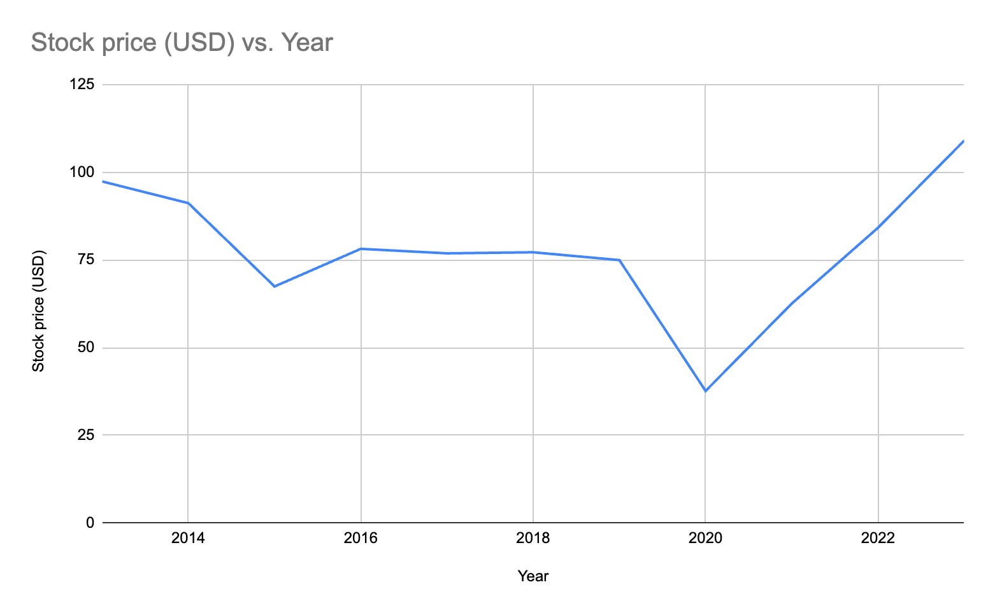
STOCK PERFORMANCE
Year | Stock price (USD)
2013 | 97.34
2014 | 91.16
2015 | 67.42
2016 | 78.14
2017 | 76.86
2018 | 77.16
2019 | 74.93
2020 | 37.66
2021 | 62.56
2022 | 84.15
2023 | 108.99
Notes:
As you can see, ExxonMobil's stock price has fluctuated significantly over the past 10 years. However, the stock has generally trended upwards, with a total return of over 140% over the period.
ExxonMobil's stock price is likely to continue to be volatile in the future. The stock is sensitive to oil and gas prices, which can fluctuate significantly depending on economic conditions and other factors. However, ExxonMobil is a well-managed company with a strong track record of profitability. The company is also investing heavily in new projects, such as its Guyana operations, which are expected to boost the company's production and revenue in the long term.

Slide 10



COMPARABLE ANALYSIS
Company Name | Ticker | Close Price (10-05-2023) | Shares Outstanding ( In Millions) | Market Capitalization | Cash | Total Debt | Net Debt | Enterprise Value | Revenue | EBIT | Depreciation And Amortization | EBITDA | EPS
VALERO | VLO | 138.09 | 358 | 49,436 | 5,075 | 11323 | 6,248 | 55,684 | 34,509 | 2,759 | 11 | 2,770 | 5.40
CONOCO PHILLIPS | COP | 117.1 | 1,210 | 141,731 | 6,815 | 16444 | 9,629 | 151,360 | 12,351 | 3,362 | 2,010 | 5,372 | 1.84
CHEVRON | CVX | 166.54 | 1,876 | 312,347 | 9,610 | 21514 | 11,904 | 324,251 | 48,896 | 7,837 | 3,521 | 11,358 | 3.20
EXXON | XOM | 108.99 | 4,066 | 443,153 | 29,528 | 41496 | 11,968 | 455,121 | 82,914 | 11,656 | 4,242 | 15,898 | 1.94
ExxonMobil is the largest and most profitable of the three companies. However, Chevron, Valero, and ConocoPhillips are all significant players in the oil and gas industry. In addition to their size and global reach, Chevron, Valero, and ConocoPhillips are also Exxon peers because they are all large, integrated energy companies that operate in the same industry and face the same challenges and opportunities.
Market capitalization (US$ billion) | Revenue (US$ billion) | Net income (US$ billion) | Employees
440.2 | 364.12 | 51.69 | 9.70k
318.24 | 214.09 | 30.17 | 43.85k
46.32 | 157.15 | 10.9 | 9.72k
148.56 | 66.73 | 12.91 | 62.00k

Slide 11
 | EV/SALES | EV/EBIT | EV/EBITDA
Min | 1.61 | 20.18 | 20.10
Mean | 6.83 | 35.53 | 25.61
Max | 12.25 | 45.02 | 28.55
 | EV/SALES | EV/EBIT | EV/EBITDA
Min | 1.61 | 20.18 | 20.10
Mean | 6.83 | 35.53 | 25.61
Max | 12.25 | 45.02 | 28.55
Implied EV
Min | $133,791.23 | $235,250.19 | $319,591.24
Mean | $566,577.36 | $414,090.98 | $407,129.75
Max | $1,016,101.29 | $524,762.86 | $453,860.19
Implied Equity
Min | $121,823 | $223,282 | $307,623
Mean | $554,609 | $402,123 | $395,162
Max | $1,004,133 | $512,795 | $441,892
Implied Stock Price
Min | $30 | $55 | $76
Mean | $136.40 | $98.90 | $97.19
Max | $247 | $126 | $109

Slide 12


PRECEDENT TRANSACTION ANALYSIS
M&A DATE | ACQUIRER NAME | TARGET NAME | TICKER | STOCK PRICE | SHARES OUTSTANDING | MARKET CAP | EBIT | EBITDA | TOTAL DEBT | CASH | EV (IN MILLION) | REVENUE | EV/REVENUE | EV/EBIT | EV/EBITDA
8/21/23 | Permian Resources Corp | Earthstone Energy Inc | ESTE | $18.94 | 107.33 | $2,032.83 | 162.08 | 1262.07 | 1021.00 | 49.50 | $3,004.33 | 1021.20 | 2.94 | 18.54 | 2.3805
8/16/23 | Energy Transfer LP | Crestwood Equity Partners LP | CEQP | $27.39 | 109.40 | $2,996.47 | 75.5 | 156.6 | 3259.10 | 7.70 | $6,247.87 | 370.00 | 16.89 | 82.75 | 39.8970
 | EXXON |  |  | 108.99 | 4,066 | 443153 | 11656 | 15,898 | 11968 | 29528 | 455,121 | 82914 | 5.49 | 39.05 | 28.63
DATE | TARGET | TICKER | ACQUIRER | DEAL VALUE ( In Billion ) | BUSINESS
8/21/23 | Earthstone Energy Inc | ESTE | Permian Resources Corp | $4.5 | OIL,GAS & COAL
8/16/23 | Crestwood Equity Partners LP | CEQP | Energy Transfer LP | $7.1 | OIL,GAS & COAL
I choose the above companies for M&A’s because both the Earth stone Energy Inc. and Crestwood Equity Partners LP are two potential precedent transactions for valuing ExxonMobil. Both companies are in the oil and gas industry. Additionally, both companies have been involved in recent transactions that are relevant to the proposed valuation of ExxonMobil.

Slide 13
PRECEDENT TRANSACTION ANALYSIS
 | EV/SALES | EV/EBIT | EV/EBITDA
Min | 2.94 | 18.54 | 2.38
Mean | 8.44 | 46.78 | 23.64
Max | 16.89 | 82.75 | 39.90
Implied EV
Min | 243929.7241 | 216056.7177 | 37844.84341
Mean | 699715.7254 | 545249.7548 | 375749.421
Max | 1400096.112 | 964571.2066 | 634282.0796
Implied Equity
Min | $231,962 | $204,089 | $25,877
Mean | $687,748 | $533,282 | $363,781
Max | $1,388,128 | $952,603 | $622,314
Implied Stock Price | EV/SALES | EV/EBIT | EV/EBITDA
Min | $57 | $50 | $6
Mean | $169 | $131 | $89
Max | $341 | $234 | $153

Slide 14
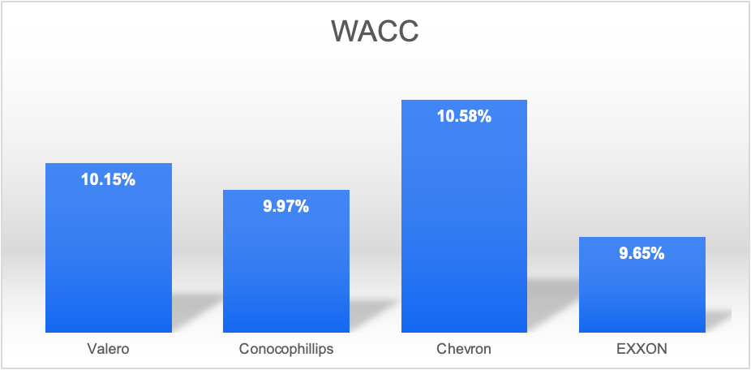
WACC CALCULATION
COST OF EQUITY
R_F | 4.73%
BETA | 1.04
MRP | 5%
R_E | 9.93%
COST OF DEBT
EXXON credit rating | AA / Aa2
Yield on AA bonds | 5.62
Historical Spread AA/Aa2 | 0.85%
R_F | 4.73%
R_D | 5.58%
Company Name | WACC
Valero | 10.15%
Conoco Phillips | 9.97%
Chevron | 10.58%
EXXON | 9.43%
WACC
W_D | 8.56%
R_D | 5.58%
T | 27%
W_E | 91.44%
R_E | 9.93%
WACC | 9.43%
TAX RATE ASSUMPTION:
(Jun 30 2023) II. Quarter | (Mar 31 2023) I. Quarter | (Dec 31 2022) IV. Quarter | (Sep 30 2022) III. Quarter | (Jun 30 2022) II . Quarter
30.05% | 29.52% | 30.71% | 20.55% | 25.50%
Exxon has a lower WACC when compared with its competitors.
Hence, Exxon looks more attractive than its peers because it is more likely to earn a higher rate of return on its investments.
Notes:
EXXON has AA / Aa2 rating which is the third highest rating in Moody's Long-term Corporate Obligation Rating. The obligations rated Aa2 are judged to be of high quality and are subject to very low credit risk
MRP is assumed to be 5% because this is the average difference between the historical return of the S&P 500 and the historical return of Treasury bills.

Slide 15
DCF ANALYSIS ASSUMPTION
DCF OPTIMISTIC
The revenue will grow by 5% from 2023 to 2024 in the case of Optimism because the demand for oil and gas has been steady and diversification may have an increase in revenue for Exxon
EBIT MARGIN
EBIT Margin for the Projection data of 16.33 is been taken from comparable analysis.
It is calculated by taking the average of the peers. We assume the EBIT MARGIN to remain stable for the following years.
NFA %
XOM net fixed assets are expected to change over year by year due to its investment in new growth projects, maintenance and replacement, and increased production volumes.
NOWC%
XOM net operating working capital is expected to remain stable in the coming years. This is due to the company's strong operating performance, its focus on working capital management, and the favorable industry outlook.
TAX RATE
By taking the average effective tax rate from past quarterly data. The average % has been taken.
ExxonMobil's total earnings for the second quarter of 2023 were $7.9 billion compared with first-quarter earnings of $11.4 billion.
DCF BASELINE
As of the date we started valuation there was a negotiation going on for Exxon to acquire Pioneers so I expect it to have an impact this year by having a drop in revenue by 17% and would recover gradually in upcoming years ​
DCF PESSIMISTIC
The revenue growth is considered to fall for the next couple of years as there are challenges for the company in terms of oil pricing and this case could occur if the company fails to adapt to the changing environment .
I proposed valuation of ExxonMobil.

Slide 16
DCF ANALYSIS OPTIMISTIC CASE
Year | 2023 | 2024 | 2025 | 2026 | 2027 | 2028 | 2029
Revenue Growth Rate | 10% | 15% | 15% | 20% | 25% | 11% | 7%
 |  | Actual |  |  | Projection
 |  | 2020 | 2021 | 2022 | 2023 | 2024 | 2025 | 2026 | 2027 | 2028 | 2029
REVENUE |  | 181502 | 285640 | 413680 | 455048 | 523305 | 601801 | 722161 | 902701 | 1001999 | 1072139
EBIT |  | -28,883 | 31,234 | 77,753 | 74288 | 85431 | 98246 | 117895 | 147369 | 163580 | 175030
EBIT*(1-TAX RATE) |  | -28883 | 31234 | 77753 | 54033 | 62138 | 71458 | 85750 | 107187 | 118978 | 127306
NFA | 253018 | 227,553 | 216,552 | 204,692 | 380217 | 437249 | 439923 | 523011 | 705540 | 769630 | 805424
CHANGE IN NFA |  | -25,465 | -11,001 | -11,860 | 175525 | 57032 | 2674 | 83089 | 182528 | 64091 | 35793
NOWC | -13,937 | -2,289 | 2,511 | 28,586 | 9902 | 11387 | 13095 | 15714 | 19643 | 21804 | 23330
CHANGES IN NOWC |  | 11,648 | 4,800 | 26,075 | -18,684 | 1,485 | 1,708 | 2,619 | 3,929 | 2,161 | 1,526
FREE CASH FLOW |  | -15,066 | 37,435 | 63,538 | -102,808 | 3,620 | 67,076 | 42 | -79,269 | 52,726 | 89,987
CONSTANT GROWTH |  | 3.00%
WACC/DISCOUNT RATE |  | 9.44%
PV OF TV |  | $765,735
PV OF FCF |  | $57,073
EV |  | 822,808
TOTAL DEBT |  | 37567
CASH |  | 29,528
EQUITY |  | 814,769
SHARES OUTSTANDING |  | 4,066
STOCKPRICE |  | $200
IMPLIED EV | 1439656
IMPLIED EV/ SALES | 1.34
 | 3% | 3.5% | 4% | 4.5% | 5% | 5.5%
8% | 280 | 311 | 349 | 399 | 465 | 558
8.5% | 247 | 272 | 302 | 340 | 388 | 453
9% | 220 | 240 | 264 | 294 | 330 | 377
9.4% | 201 | 218 | 238 | 262 | 291 | 328
10% | 179 | 192 | 208 | 227 | 250 | 278
10.5% | 162 | 174 | 187 | 203 | 221 | 243
11% | 148 | 158 | 169 | 182 | 197 | 215
Notes:
DCF OPTIMISTIC
The revenue will grow by 5% from 2023 to 2024 in the case of Optimism because the demand for oil and gas has been steady and diversification may have an increase in revenue for Exxon
EBIT MARGIN
EBIT Margin for the Projection data of 16.33 is been taken from comparable analysis.
It is calculated by taking the average of the peers. We assume the EBIT MARGIN to remain stable for the following years.
NFA %
XOM net fixed assets are expected to change over year by year due to its investment in new growth projects, maintenance and replacement, and increased production volumes.
NOWC%
XOM net operating working capital is expected to remain stable in the coming years. This is due to the company's strong operating performance, its focus on working capital management, and the favorable industry outlook.
TAX RATE
By taking the average effective tax rate from past quarterly data. The average % has been taken.
Analysts estimates Exxon future growth rate would be between 2% to 4%. A 3% growth rate is considered to be a reasonable assumption given company’s strong fundamentals and expected growth in global energy demand .
By increase in growth rate our stock price increases from 201-328$ is observed from performing sensitivity analysis

Slide 17
DCF ANALYSIS BASELINE CASE
Year | 2023 | 2024 | 2025 | 2026 | 2027 | 2028 | 2029
Revenue Growth Rate | -17% | -5% | 13% | 12% | 10% | 7% | 5%
 |  | Actual |  |  | Projection
 |  | 2020 | 2021 | 2022 | 2023 | 2024 | 2025 | 2026 | 2027 | 2028 | 2029
REVENUE |  | 181502 | 285640 | 413680 | 343354 | 326187 | 368591 | 412822 | 454104 | 485891 | 510186
EBIT |  | -28,883 | 31,234 | 77,753 | 56054 | 53251 | 60174 | 67395 | 74134 | 79323 | 83290
EBIT*(1-TAX RATE) |  | -28883 | 31234 | 77753 | 40919 | 38873 | 43927 | 49198 | 54118 | 57906 | 60801
NFA | 253018 | 227,553 | 216,552 | 204,692 | 286891 | 272546 | 269444 | 298978 | 354922 | 373211 | 383267
CHANGE IN NFA |  | -25,465 | -11,001 | -11,860 | 82199 | -14345 | -3102 | 29534 | 55943 | 18289 | 10057
NOWC | -13,937 | -2,289 | 2,511 | 28,586 | 7472 | 7098 | 8021 | 8983 | 9881 | 10573 | 11102
CHANGES IN NOWC |  | 11,648 | 4,800 | 26,075 | -21,114 | -374 | 923 | 962 | 898 | 692 | 529
FREE CASH FLOW |  | -15,066 | 37,435 | 63,538 | -20,165 | 53,591 | 46,106 | 18,701 | -2724 | 38,295 | 50,216
CONSTANT GROWTH |  | 3.00%
WACC/DISCOUNT RATE |  | 9.43%
PV OF TV |  | $428,325
PV OF FCF |  | $159,260
EV |  | 587,586
TOTAL DEBT |  | 37567
CASH |  | 29,528
EQUITY |  | 579,547
SHARES OUTSTANDING |  | 4,066
STOCKPRICE |  | $143
IMPLIED EV | 804735
IMPLIED EV/ SALES | 1.58
 | 3% | 3.5% | 4% | 4.5% | 5% | 5.5%
8% | 189 | 206 | 228 | 255 | 292 | 344
8.5% | 170 | 184 | 200 | 221 | 248 | 284
9% | 154 | 165 | 179 | 195 | 215 | 242
9.4% | 142 | 152 | 163 | 176 | 193 | 214
10% | 129 | 137 | 146 | 156 | 169 | 185
10.5% | 119 | 126 | 133 | 142 | 152 | 165
11% | 111 | 116 | 123 | 130 | 138 | 148
Notes:
DCF BASELINE
As of the date we started valuation there was a negotiation going on for Exxon to acquire Pioneers so I expect it to have an impact this year by having a drop in revenue by 17% and would recover gradually in upcoming years
By increase in growth rate our stock price increases from 142-214 $

Slide 18
DCF ANALYSIS PESSIMISTIC CASE
Year | 2023 | 2024 | 2025 | 2026 | 2027 | 2028 | 2029
Revenue Growth Rate | -20% | -10% | 5% | 8% | 7% | 5% | 3%
 |  | Actual |  |  | Projection
 |  | 2020 | 2021 | 2022 | 2023 | 2024 | 2025 | 2026 | 2027 | 2028 | 2029
REVENUE |  | 181502 | 285640 | 413680 | 330944 | 264755 | 238280 | 214452 | 225174 | 243188 | 260211
EBIT |  | -28,883 | 31,234 | 77,753 | 54028 | 43222 | 38900 | 35010 | 36760 | 39701 | 42480
EBIT*(1-TAX RATE) |  | -28883 | 31234 | 77753 | 39297 | 31437 | 28293 | 25464 | 26737 | 28876 | 30898
NFA | 253018 | 227,553 | 216,552 | 204,692 | 276521 | 221217 | 174185 | 155313 | 175993 | 186792 | 195479
CHANGE IN NFA |  | -25,465 | -11,001 | -11,860 | 71829 | -55304 | -47032 | -18872 | 20681 | 10798 | 8687
NOWC | -13,937 | -2,289 | 2,511 | 28,586 | 7201 | 5761 | 5185 | 4667 | 4900 | 5292 | 5662
CHANGES IN NOWC |  | 11,648 | 4,800 | 26,075 | -21,385 | -1,440 | -576 | -519 | 233 | 392 | 370
FREE CASH FLOW |  | -15,066 | 37,435 | 63,538 | -11,148 | 88,182 | 75,902 | 44,855 | 5,823 | 17,686 | 21,840
CONSTANT GROWTH |  | 3.00%
WACC/DISCOUNT RATE |  | 9.44%
PV OF TV |  | $185,846
PV OF FCF |  | $201,955
EV |  | 387,801
TOTAL DEBT |  | 37567
CASH |  | 29,528
EQUITY |  | 379,762
SHARES OUTSTANDING |  | 4,066
STOCKPRICE |  | $93
IMPLIED EV | 349409
IMPLIED EV/ SALES | 1.34
 | 3% | 3.5% | 4% | 4.5% | 5% | 5.5%
8% | 116 | 123 | 133 | 145 | 161 | 184
8.5% | 107 | 113 | 120 | 129 | 141 | 157
9% | 99 | 104 | 110 | 117 | 126 | 137
9.4% | 93 | 97 | 102 | 108 | 115 | 124
10% | 87 | 90 | 94 | 99 | 104 | 111
10.5% | 82 | 85 | 88 | 92 | 96 | 102
11% | 77 | 80 | 83 | 86 | 89 | 94
Notes:
DCF PESSIMISTIC
The revenue growth is considered to fall for the next couple of years as there are challenges for the company in terms of oil pricing and this case could occur if the company fails to adapt to the changing environment .
By increase in growth rate our stock price increases from 93-124 $

Slide 19
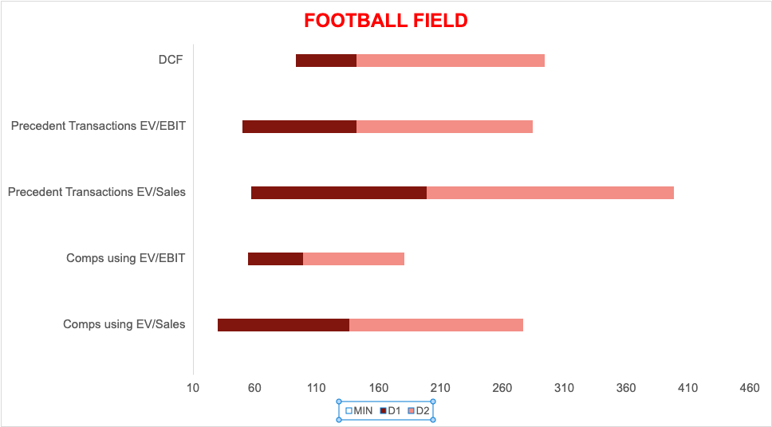

Notes:
As per our valuation ,The stock price can range from 100 to 210 $, so as per foot ball field we could say that the current stock price is in our range and it is recommended from this football field to purchase those shares in the point of long term investor.

Slide 20
CONCLUSION
As per our valuation, According to DCF and Comps our share price is 142$ and 136$ respectively and XOM was trading at the Market Price of $108, so I would say that the stock is undervalued.
As of 2023/10/5, the intrinsic value of XOM is. $142.53 with the current market price of $ 108.99
The upside of Exxon Mobil is 45.5%.
As per our Comps Analysis, our implied stock price is $136.40 (As per EV/SALES), The upside of Exxon Mobil is 55.9%
Looking at both scenerio our stock price is undervalued.
Exxon's strong dividend payout is one of the things that makes the stock attractive to investors in the future.
The quarterly Exxon dividend amount is 0.91 USD. The current dividend yield of Exxon Mobil Corp (XOM) is 3.28.This means that shareholders receive a quarterly dividend of $0.91 per share. Exxon Mobil has a long history of paying dividends, and it is expected to grow in the future so, I would recommend buying the shares if you are looking for better dividend-generating shares in near future.
Since there is scope for development in the price of crude oil there is a direct relation with Exxon as it is known to be a blue chip in the field of the oil industry as per investors of the New York stock market.
Exxon Mobil's growth has been strong recently, with the company reporting a 30.13% return on investment for the trailing twelve months ended June 30, 2023. This is a significant increase from the previous year's ROI of 14.69%.
Exxon's growth has been driven by number of factors, including higher oil prices, and production growth from its Permian Basin and Guyana operations.
This recommendation is provided for investors who are looking forward to better returns in the long term because of certain factors they may face a certain drop in share price but Exxon’s commitment for future growth clearly shows the potential in the company for investment in its shares.
Hence, the recommendation for Exxon shares is to BUY.

Slide 21
THANK YOU

